Slide 1
Analytics report on employee data of DDSAnalytics
Presenter: Suchismita Moharana

Slide 2
Employee Count for Job Title
This graph on the right shows count of employees for each job titles that we have in the data.

Slide 3
Attrition Percentage for each job title
The graph here clearly states that turnover rate is high for Sales Representatives.

Slide 4
Attrition rate for employees working over time
The graph on the right states that turnover rate is high for employees who work more overtime.

Slide 5
Attrition Rate for employees who travel more for work
The graph here clearly states that turnover rate is high for frequent travelers.

Slide 6
Monthly Income graph for Job Role

Slide 7
Impact of Work Experience vs Monthly Income on Attrition

Slide 8
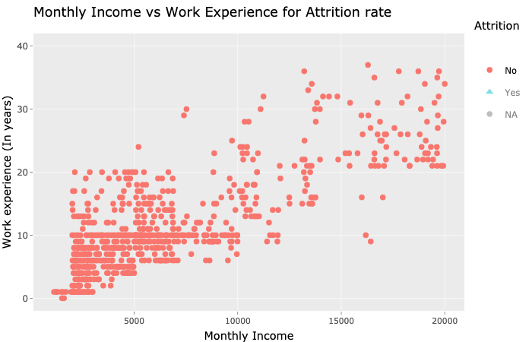
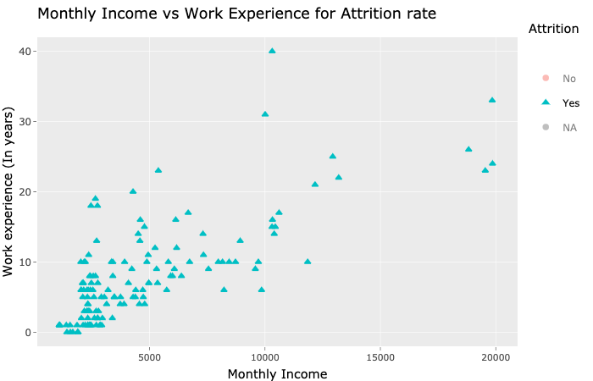
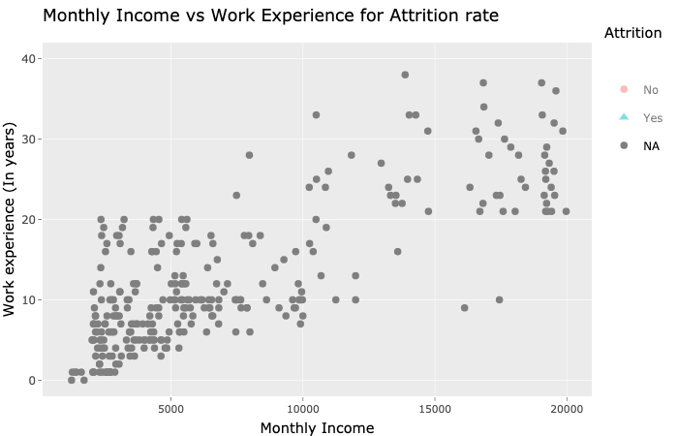
Comparison between NOs, YESs & NAs
For NO
For YES
For NA

Slide 9
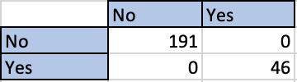
Naïve Bayes Modeling to Predict Attrition
The result are below which was received from Naïve Bayes modeling based on the parameters that we discussed.
So, the attrition rate would be high for those employees who are in low income group (like Sales Representative) doing overtime and who Travel frequently.

Slide 10
Comparison of Job Satisfaction among employees
The above graph is to show the job satisfaction comparison between different job role that employees have

Slide 11
Conclusion
In my opinion, attrition is related to low income, more over time work and more work related travel.

Slide 12
Thank You!
Presenter: Suchismita Moharana

